Slide 1



Basmah Almashari
Sarah Aljathlan
Eshrag Alosaimi

Slide 2

Table of Content
Problems
Solutions
Gamification
Achievement
Technologies
Values
Future Plan

Slide 3
How we Find the problem?
The students need place to discuses the projects.
For freelancers and people works from home to provide them calm atmosphere
A startup have unused resource (rooms)

Slide 4

Solutions
Web service help to find shared office and the lower prices in the city.

Slide 5
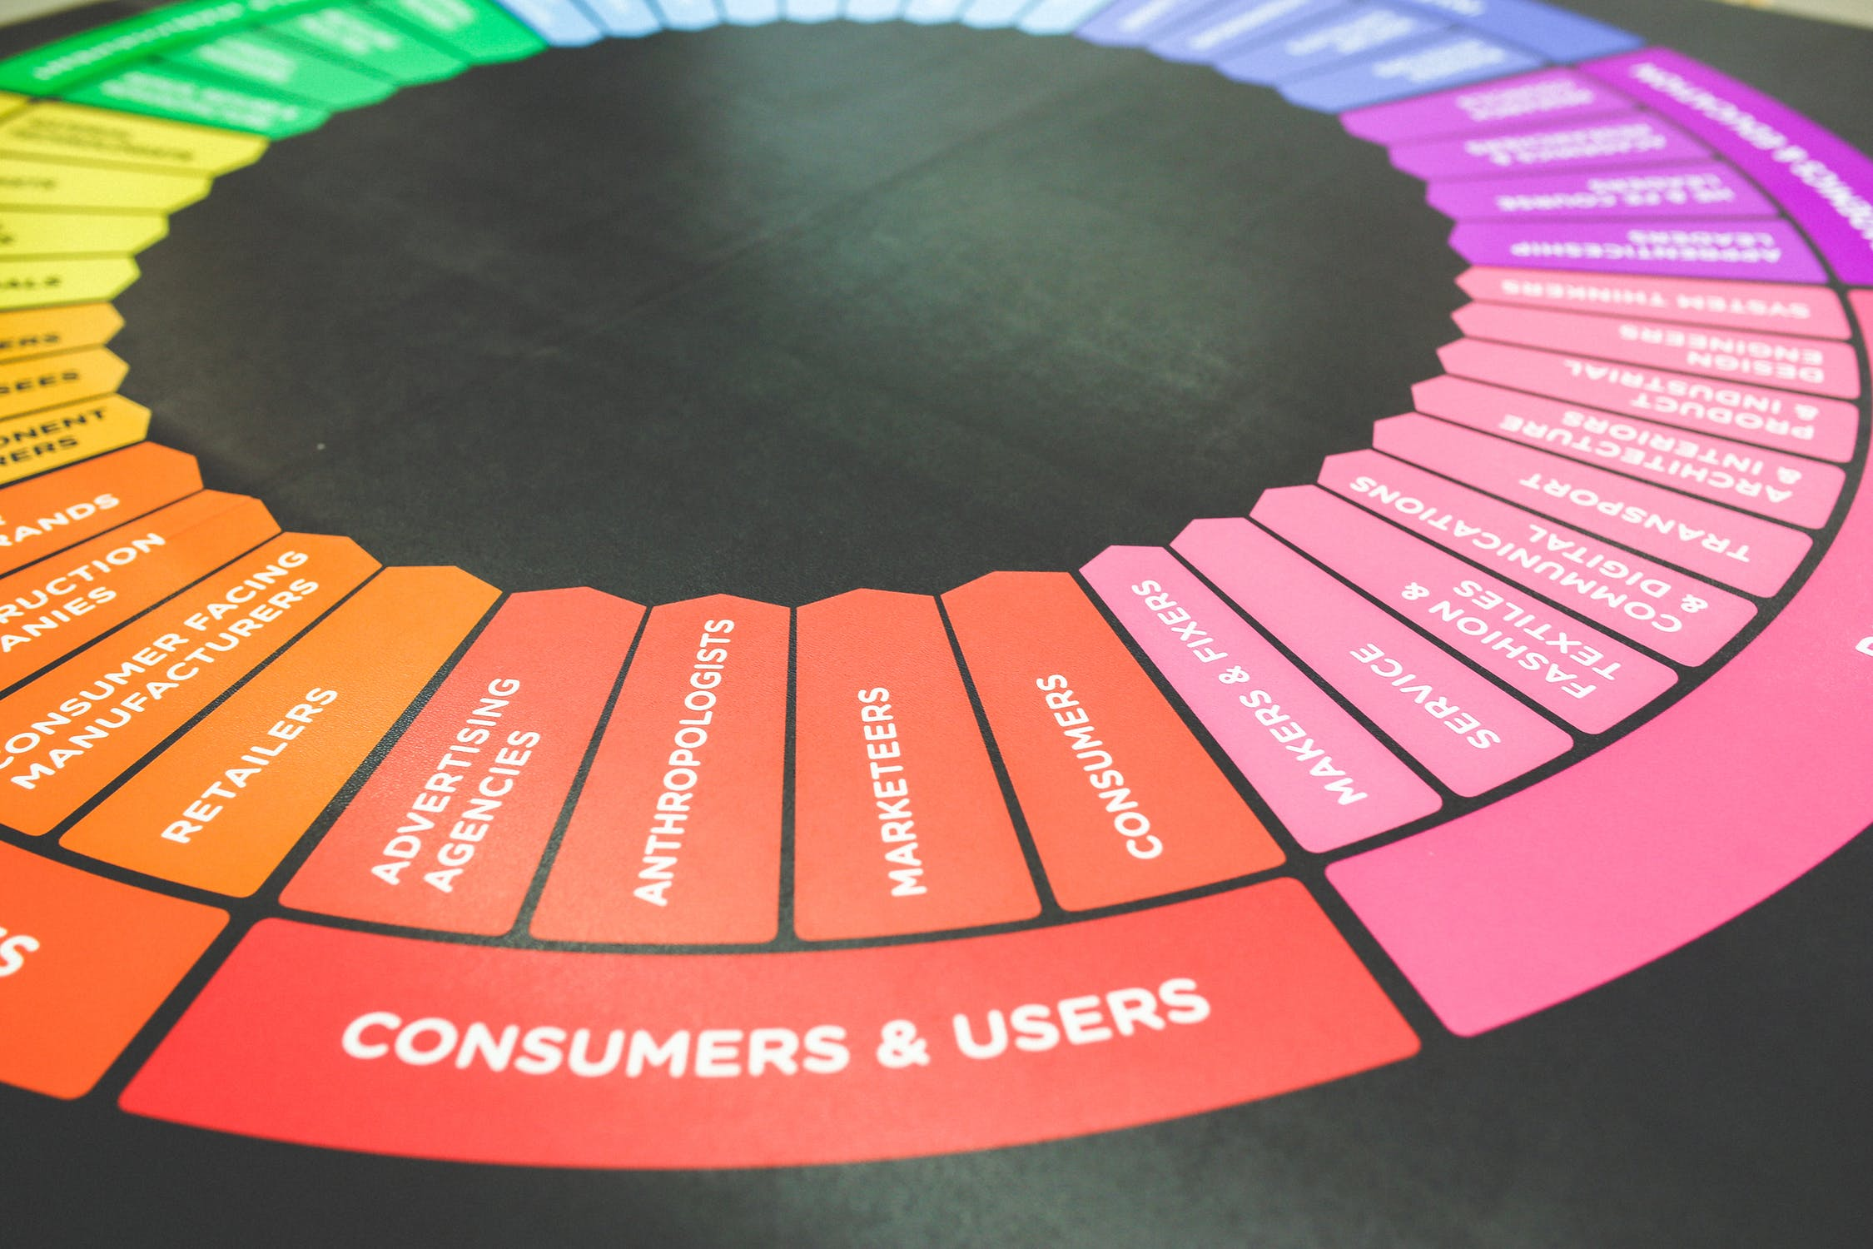
Gamification
badges for check-in
Rating the office
Loyalty membership

Slide 6
Prototype

Slide 7
Link for prototype
Video demo
Click here
Interactive demo
Click here

Slide 8
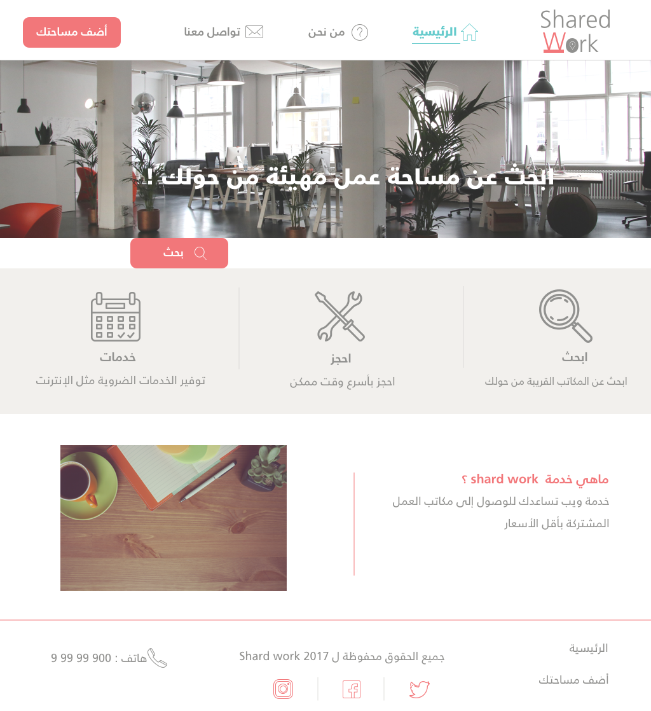

Slide 9
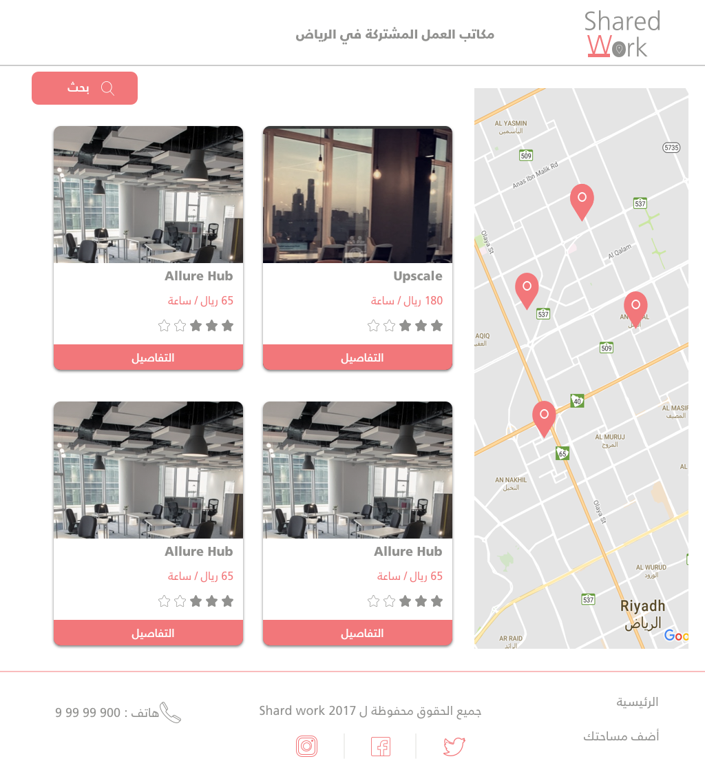

Slide 10
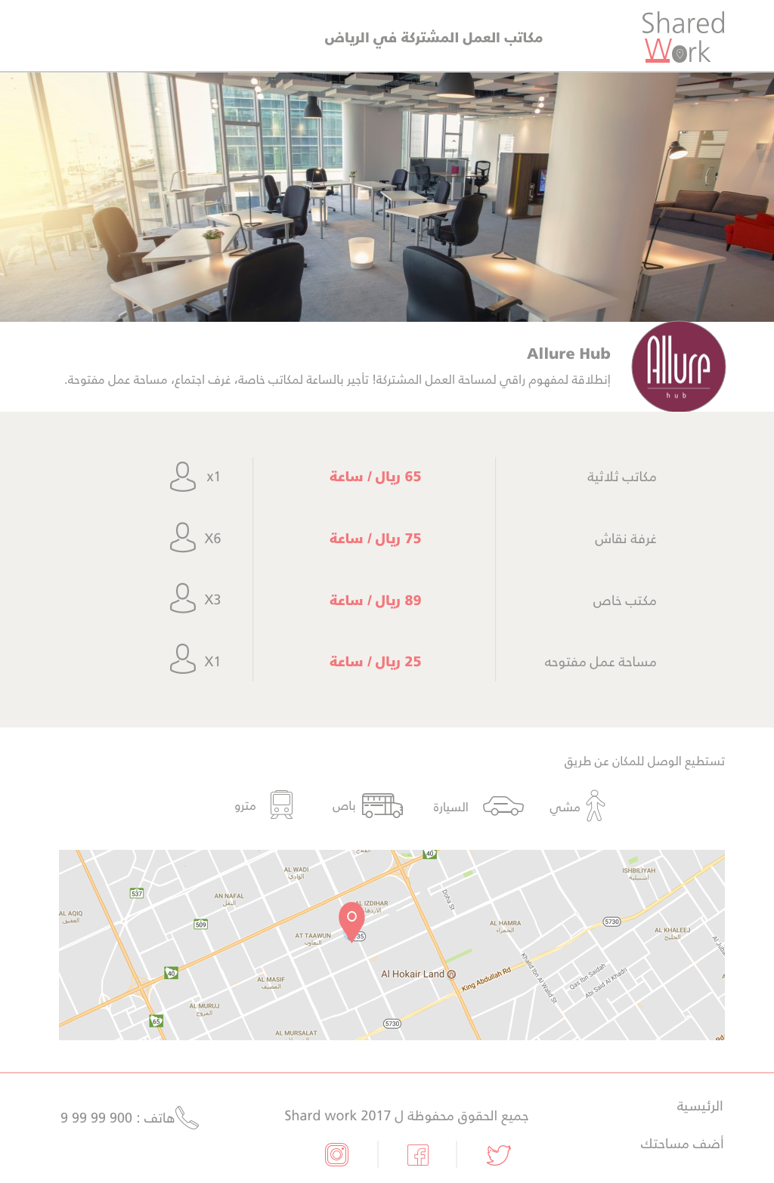

Slide 11
Technologies
Api (Google maps)
Responsive bootstraps
Knockout
Javascript
CSS
Sketch app
Imgs (pexels)
Icon (Iconflat), font awesome

Slide 12
^{Achievements}
Profit By Promoting
MVC
MVP
Web Service
Service Providers
Customer
Responsive
Prototype

Slide 13
Values
Support freelancers and people work from work
Share knowledge and connections between businesses owners
Awareness about the shard office works in the community
Social service, Marketing for Companies
Use unused resource for extra income

Slide 14
Future Plan
Add more cites and places
Service providers can add their work space
Trending place
Use routing algorithms
Virtual reality (VR) to explore the offices
Add categories and hotels , cafe,offices

Slide 15
Q/A
Thank you for listening!

